Slide 1
Exploring the relationship between food affordability and multiple factors

Slide 2
Summary of the dataset
Why we should focus on food affordability?
Visualisations and summary statistics I made
Some challenges that my code presented
Content

Slide 3
Summary of the dataset
This table contains data on the average cost of a nutritious basket of foods for female-headed households with children relative to income for California and its regions, counties, and cities/towns. The ratios use data from the U.S. Department of Agriculture and the U.S. Census Bureau. This table is part of a suite of indicators from the Healthy Communities Data and Indicators Project of the Office of Health Equity.
Notes:
Introduction to the content of the dataset.

Slide 4
Why we should focus on food affordability?
One of the indispensable activities in human life is eating. However, insufficient diet can affect human health, such as cardiovascular disease, certain cancers, obesity and anemia. We will analyze the relationship between food affordability and various influencing factors, so as to facilitate future policy support for vulnerable groups.
Notes:
Explain why this dataset was chosen and what impact this research can have on society.

Slide 5
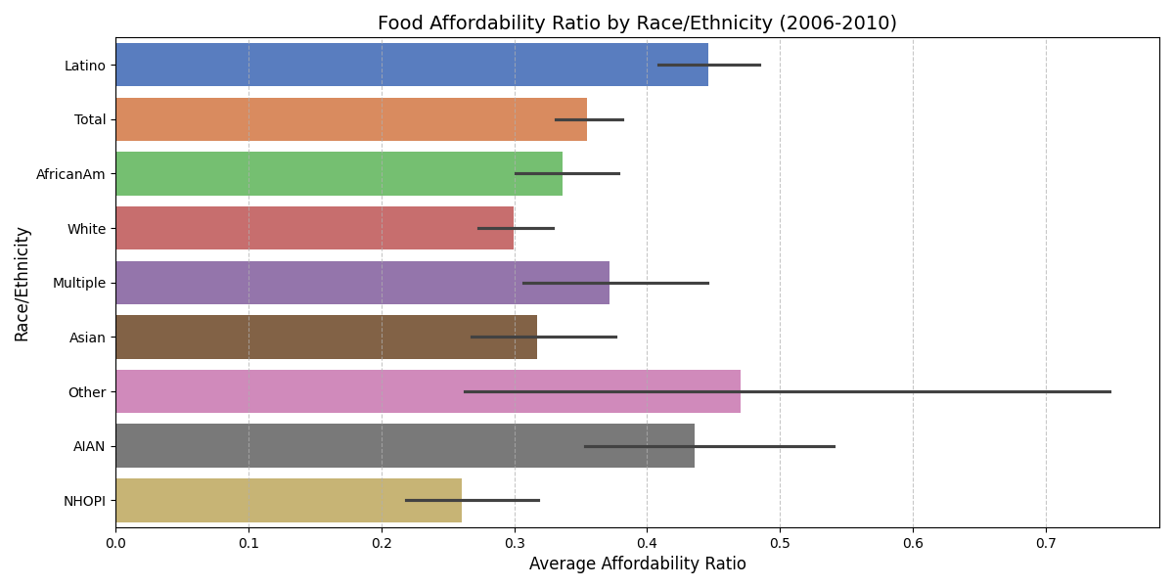
Food Affordability by Race
Latino and Multiple show high affordability ratios (over 0.4), indicating lower food affordability.
NHOPI also has relatively high ratios. White and Asian have lower ratios (under 0.3), showing higher food affordability. The overall ratio is about 0.35, indicating moderate affordability.
Other and AIAN have larger error margins, suggesting data volatility, possibly due to small sample size or heterogeneity.
Latino and Asian have smaller error margins, reflecting more reliable data.
Notes:
Describe food affordability rates by race from 2006 to 2010.

Slide 6
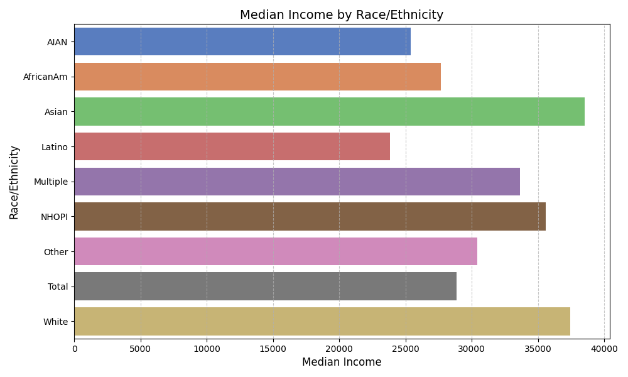
Median Income by Race
Asians have the highest median income, close to 40,000
Whites also have a higher median income, slightly lower than Asians, but still significantly higher than other ethnic groups
NHOPI and Multiples have a median income of about 30,000
African Americans and Latinos have a lower median income, less than 30,000
Notes:
Analyze the median income of different races to see if it has any bearing on food affordability.

Slide 7
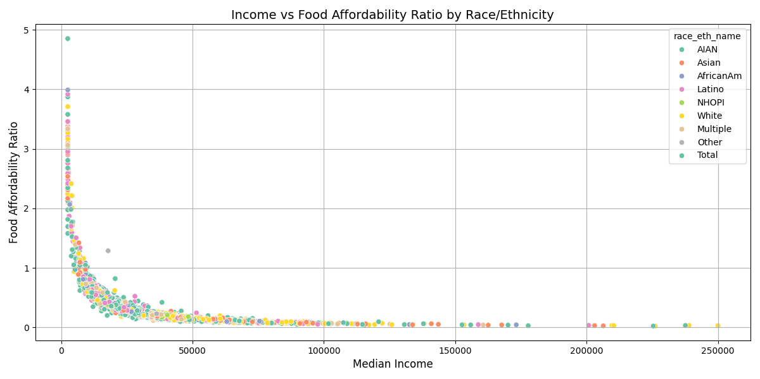
The Relationship Between Race, Income and Food affordability
There is a strong negative correlation between income and food affordability.
In the low-income segment (< $20,000), the food affordability ratio is higher (>1), indicating that the low-income group has a heavier food cost burden.
The food affordability ratio of the high-income segment (> $100,000) is close to 0, indicating that the high-income group has almost no food affordability problem.
The Latino and AfricanAm groups have more points in the low-income segment and poor food affordability.
The White and Asian groups have more points in the high-income segment and their food affordability has improved significantly.
Notes:
Further dissecting the impact of income factors on different races.

Slide 8
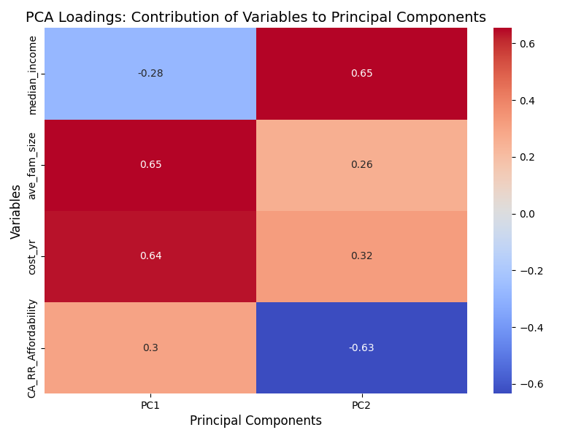
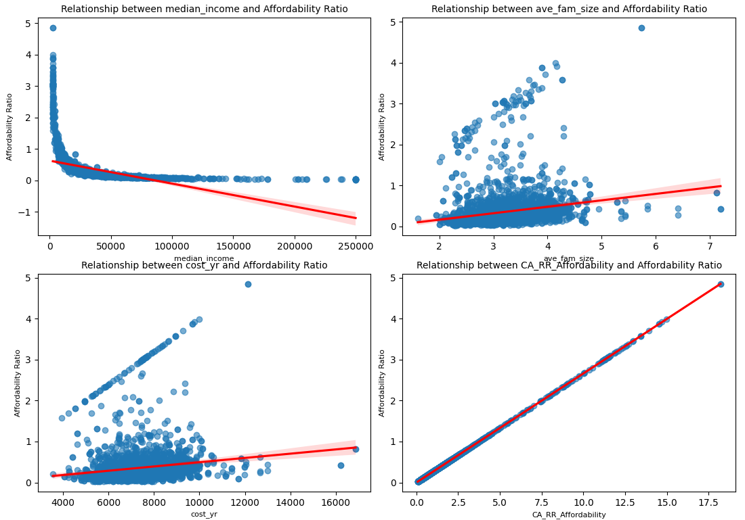
The relationship between multiple factors and food affordability
The main influencing factors are household size and annual food costs (PC1), followed by income and relative food affordability (PC2).
Income and food costs have the most significant impact on food affordability.
Household size has a certain impact on food affordability, especially in large households.
Relative food affordability is a direct reflection of food affordability, and its changes are completely driven by other variables.
Notes:
Explain the relationship between median income, household size, annual food costs, and relative food affordability and food affordability.

Slide 9
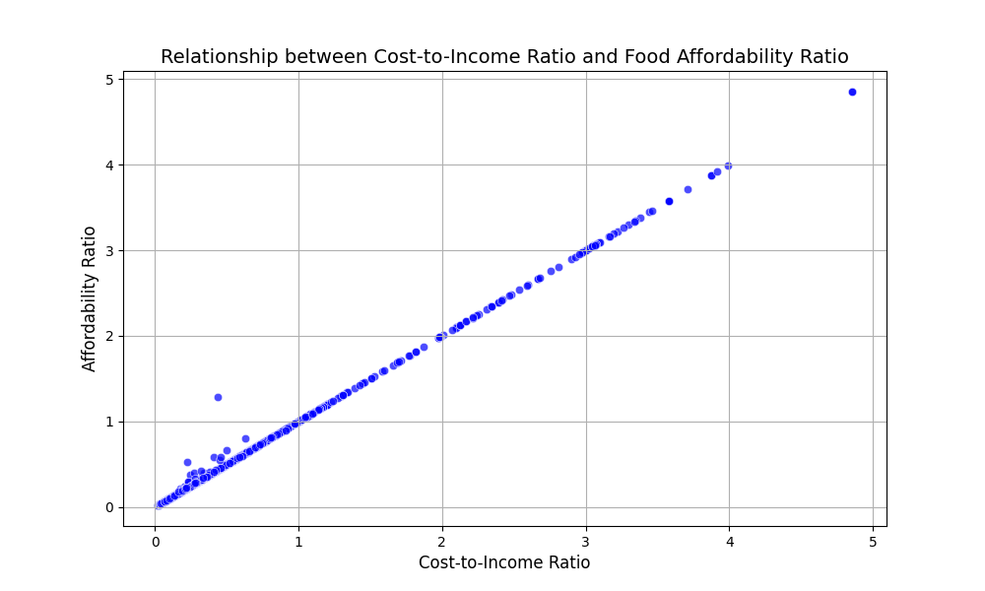
Analysis Of The Ratio Of Food Cost To Income
The graph shows an almost linear relationship between the Cost-to-Income Ratio and the Affordability Ratio, indicating that the proportion of food costs to income directly determines the food affordability ratio.
A high Cost-to-Income Ratio means that the household's food expenses are high relative to income, and therefore the food affordability ratio is also high.
Notes:
The ratio that shows that food costs as a percentage of income directly determines food affordability.

Slide 10
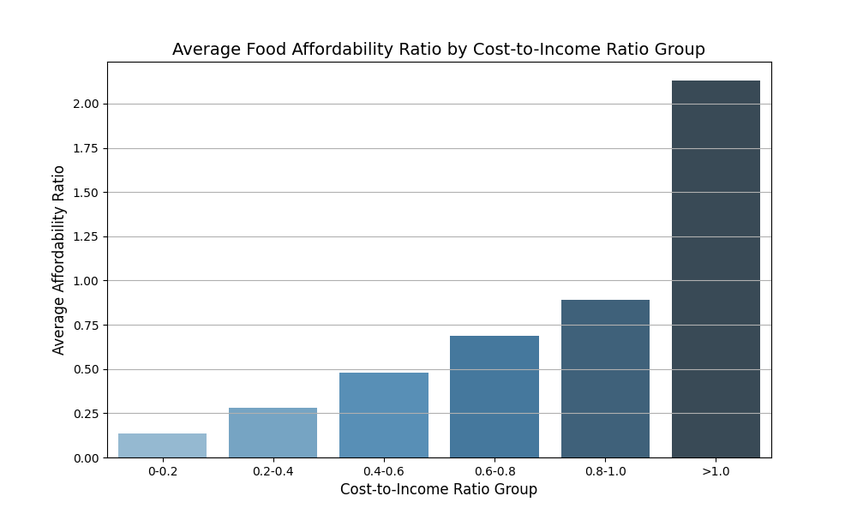
Analysis Of The Ratio Of Food Cost To Income
As the Cost-to-Income Ratio group increases, the average food affordability ratio also increases significantly.
When the Cost-to-Income Ratio exceeds 1.0, the food affordability ratio rises sharply. Households with Cost-to-Income Ratio > 1.0 are at high risk and are the main group with low food affordability.
Notes:
Dissecting the impact of food cost-to-income ratio on food affordability.

Slide 11
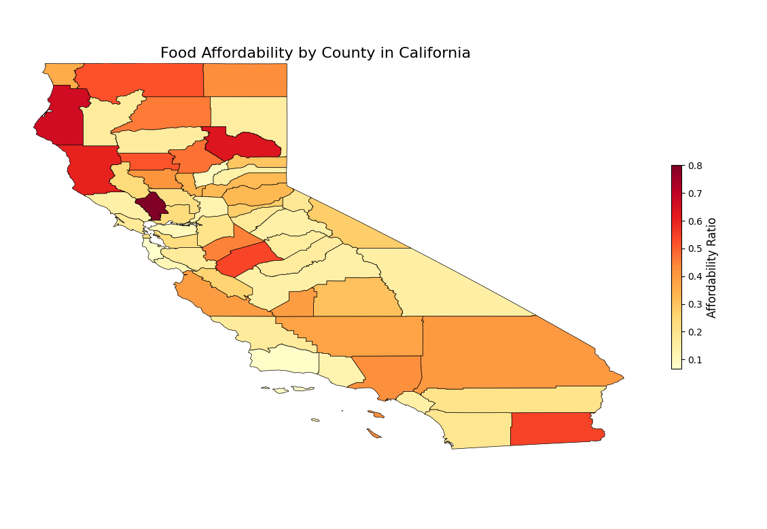
Food Affordability in California
Some counties in northern and central California have higher food affordability ratios, such as those near the coast.
Southern California and some counties near the southeast have lower food affordability ratios, suggesting that residents in these areas have relatively higher incomes or relatively lower food costs.
Notes:
Geographic heat map showing differences in food affordability across California counties.

Slide 12
Challenges With Code
When grouping data, define appropriate bins and labels, which need to be adjusted according to the data distribution characteristics.
Grouping may result in no data in some bins, causing the grouping statistics to be empty.
Use the pd.cut() function to group the data into specified intervals:
Check whether the grouped data is evenly distributed and avoid empty groups:

Slide 13
Thank you for listening!

